Slide 1


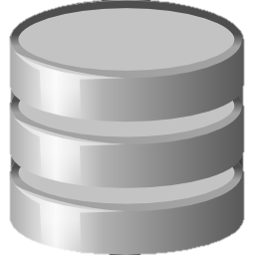

MatplotLib BootCamp with Python
Soumil Nitin Shah
Bachelor in Electronic Engineering
Master in Electrical Engineering
Master in Computer Engineering
Graduate Research and Teaching Assistant

Slide 2
What is MatplotLib
Matplotlib is a Python 2D plotting library which produces publication quality figures in a variety of hardcopy formats and interactive environments across platforms. Matplotlib can be used in Python scripts, the Python and IPython shells, the Jupyter notebook, web application servers, and four graphical user interface toolkits.
Matplotlib tries to make easy things easy and hard things possible
You can generate plots, histograms, power spectra, bar charts, errorcharts, scatterplots, etc., with just a few lines of code.
.

Slide 3
Installation Guide
You can install matplotlib by following commands into the CMD
Linux
python -m pip install -U pip python -m pip install -U matplotlib
sudo apt-get install python3-matplotlib

Slide 4
Basics Numpy
NumPy is the fundamental package for scientific computing with Python. It contains among other things:
a powerful N-dimensional array object
sophisticated (broadcasting) functions
tools for integrating C/C++ and Fortran code
useful linear algebra, Fourier transform, and random number capabilities
Besides its obvious scientific uses, NumPy can also be used as an efficient mul

Slide 5
Prerequisite
# converting List to NUMPY Array my_list= [1,2,3] print(type(np.array(my_list))) # creating matrix ofzeros and one z=np.zeros(3) z1=np.zeros((3,2)) # creating one o1=np.ones((3,2)) print(o1)

Slide 6
Prerequisite
# create even points from Point A to point B lp=np.linspace(0,10,10) print(lp) # creating random Matrix rand=np.random.randint(0,20,(3,2)) print(rand)

Slide 7
First Plot
import numpy as np import matplotlib.pyplot as plt x=np.random.randint(0,20,10) y=np.random.randint(0,20,10) print(x,y) plt.plot(x,y) plt.show()

Slide 8
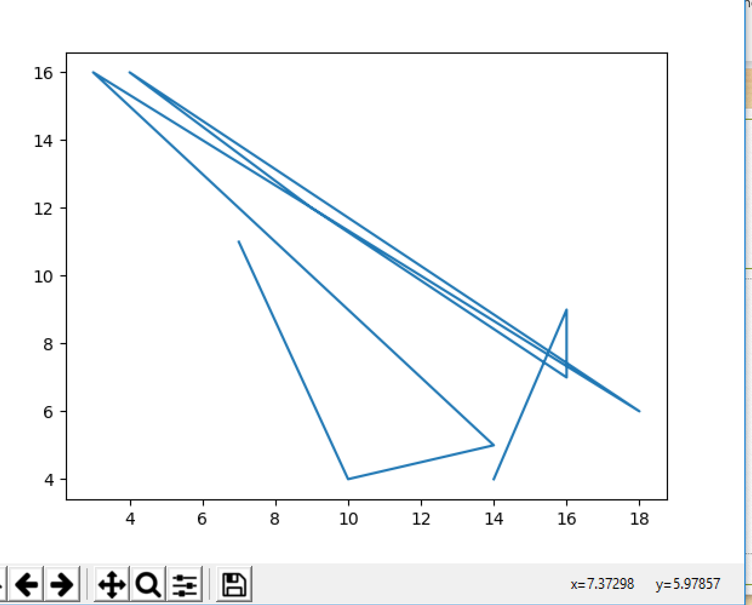
Output

Slide 9
Legends Function
Legend can be thought of marker.It is usually used when you are plotting two or more than two Lines. Lets us see and example where legend can be useful.

Slide 10
Code
import numpy as np import matplotlib.pyplot as plt x=np.random.randint(0,20,10) y=np.random.randint(0,20,10) x1=np.random.randint(1,40,10) y1=np.random.randint(1,40,10) print(x,y) plt.plot(x,y,label="First Line ") plt.plot(x1,y1,label="Second Line ") plt.legend() plt.show()

Slide 11
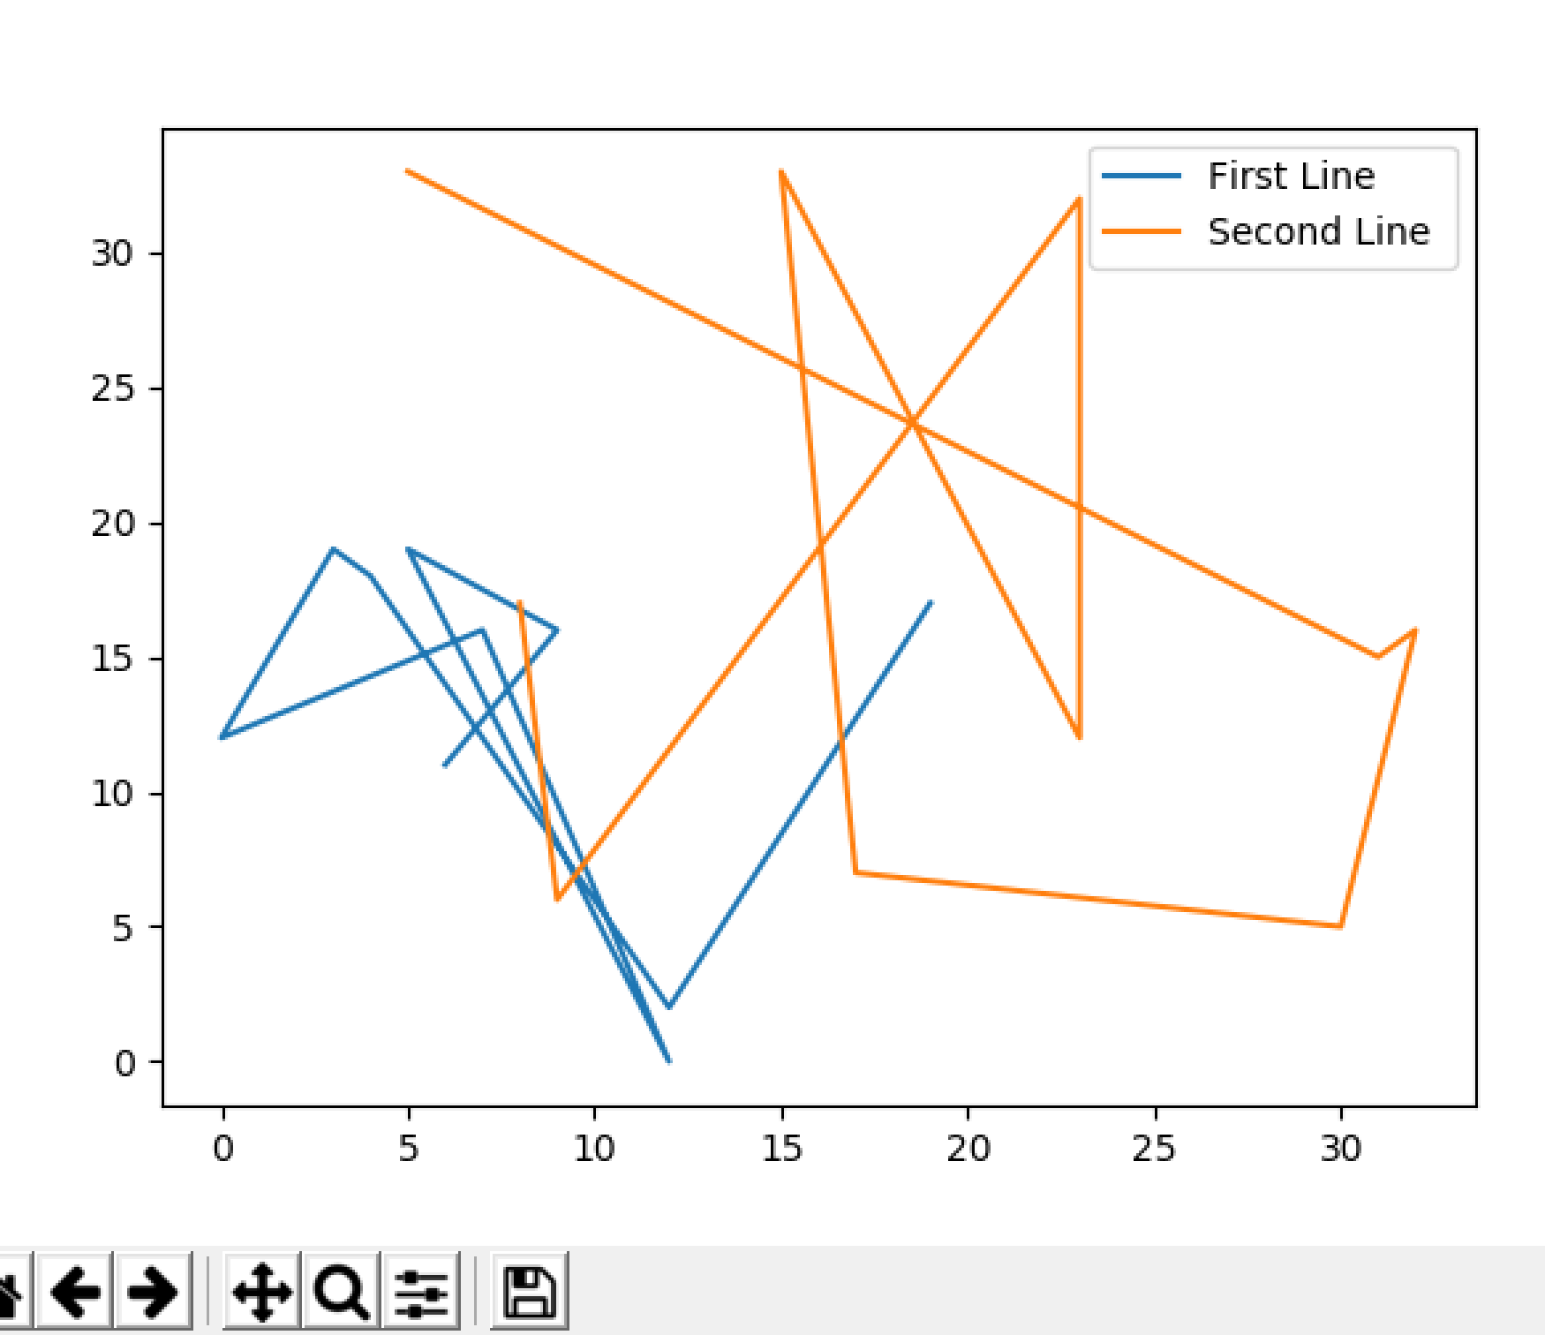
Output

Slide 12
PLOT Function
What are parameter that plot() function can take lets see them one by one
()= linewidth=2
()=color=“r”
()=linestyle=“-”
()=label=“hello”
()= marker=“*”

Slide 13
Customizing Graph
plt.xlabel("X axis")
plt.ylabel("y axis ")
plt.title("My Tittle ")
plt.ylim(0,4) # set bottom and top limit
plt.xlim(0,4) # set bottom left and right limit

Slide 14
Styles
Matplot lib already has lot of styles for you to use you can find the styles by using following command.
from matplotlib import style print(plt.style.available) style.use('ggplot’)

Slide 15
Bar,Line,Stack Plot
There are various types of Graph and charts you can use following are the command go ahead and try ypurself a few of them
plt.bar() plt.scatter() plt.stackplot() plt.pie() plt.hist()

Slide 16
Better Way to Code
Better way to Code go ahead and import Library
try: import matplotlib.pyplot as plt import numpy as np from matplotlib import style except: print("Import Error ")

Slide 17
Better way to make charts
First we need to create an Axis and create a Grid or subplot
Subplot(111) indicate that one row one column place the chart on first row and first column.
You can add multiple Graph on same window.
style.use('ggplot') fig=plt.figure() ax1=fig.add_subplot(111)

Slide 18
Understanding Subplot and Axis
First we define a axis and figure to plot in matplotlib and we do that by saying command.
The subplot command is used to plot multiple graph on same figure let see an example in action.
fig=plt.figure() ax1=fig.add_subplot(111)

Slide 19
Adding Multiple Subplot in same Window
If we want to add two graph on same wndow we can do that by following command.
fig=plt.figure() ax1=fig.add_subplot(211) ax1.plot(x,y) ax2=fig.add_subplot(212) ax2.plot(x1,y1) plt.show()

Slide 20
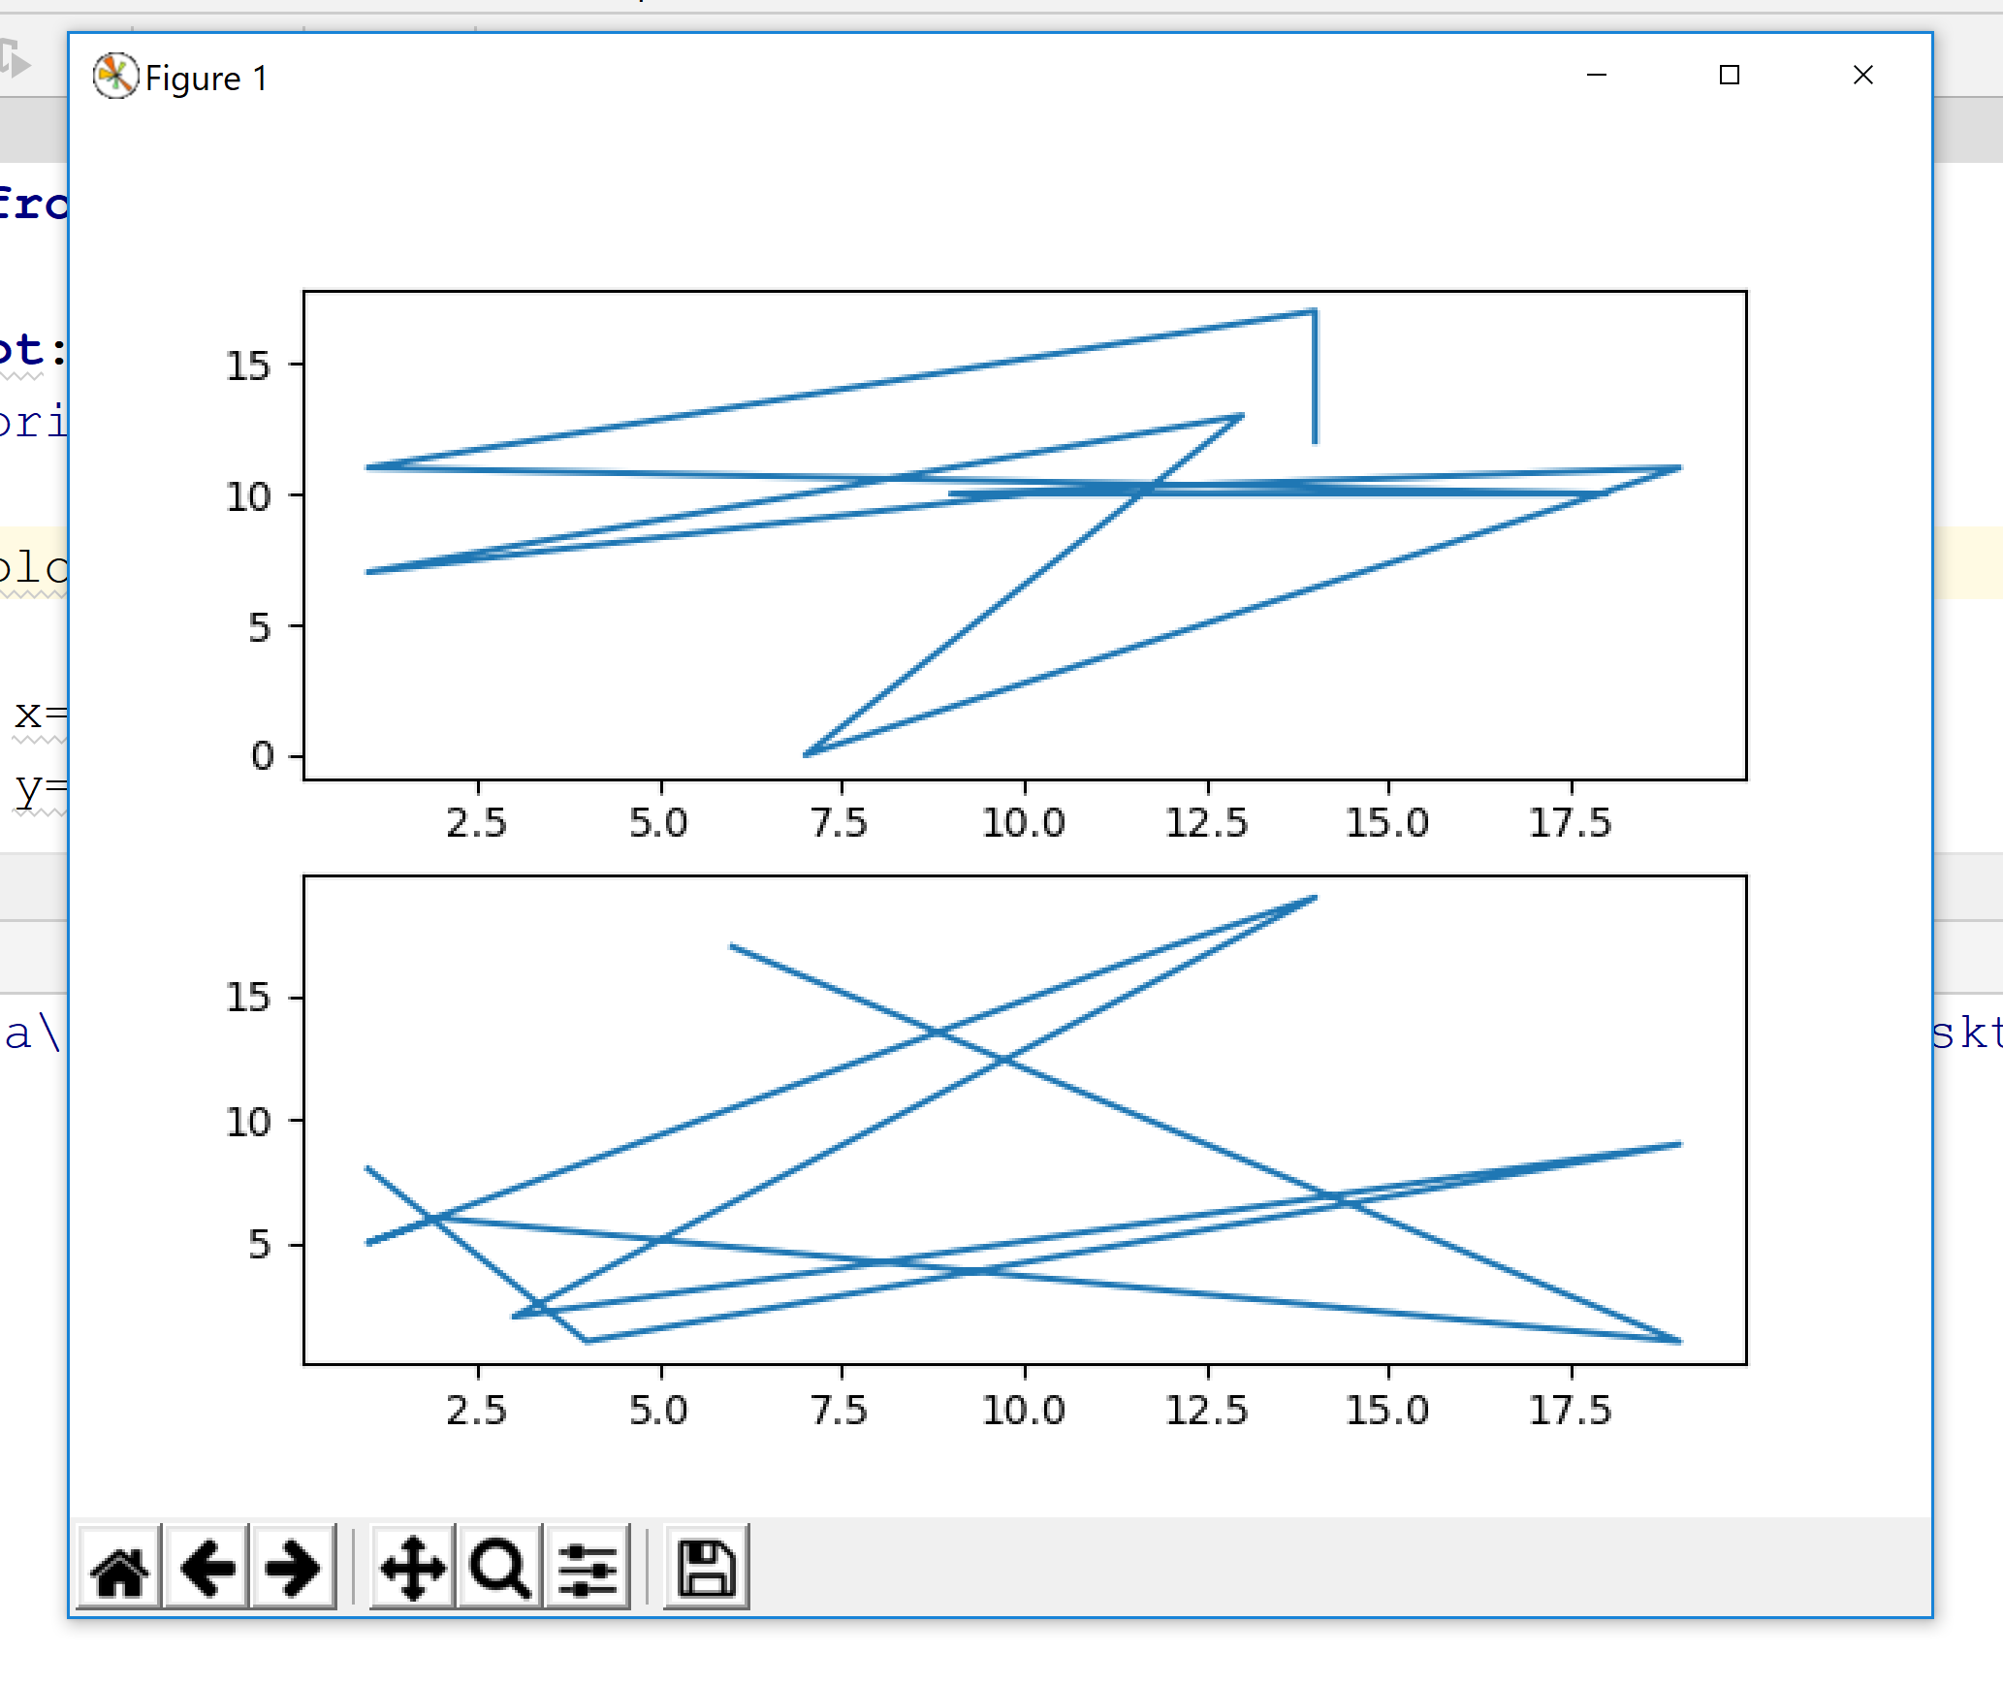
Output

Slide 21
Adding more Features to Graph
x=np.random.randint(0,30,10) y=np.random.randint(0,20,10) ax1.plot(x,y,label="First Chart",linewidth=2,color="r") ax1.grid(True,color="G",linewidth=0.2,linestyle="-") ax1.set_yticks([1,2,3,4,5,6,7]) ax1.fill_between(x,y,where=(y > 3),alpha=0.2) for label in ax1.xaxis.get_ticklabels(): label.set_rotation(45) plt.show()

Slide 22
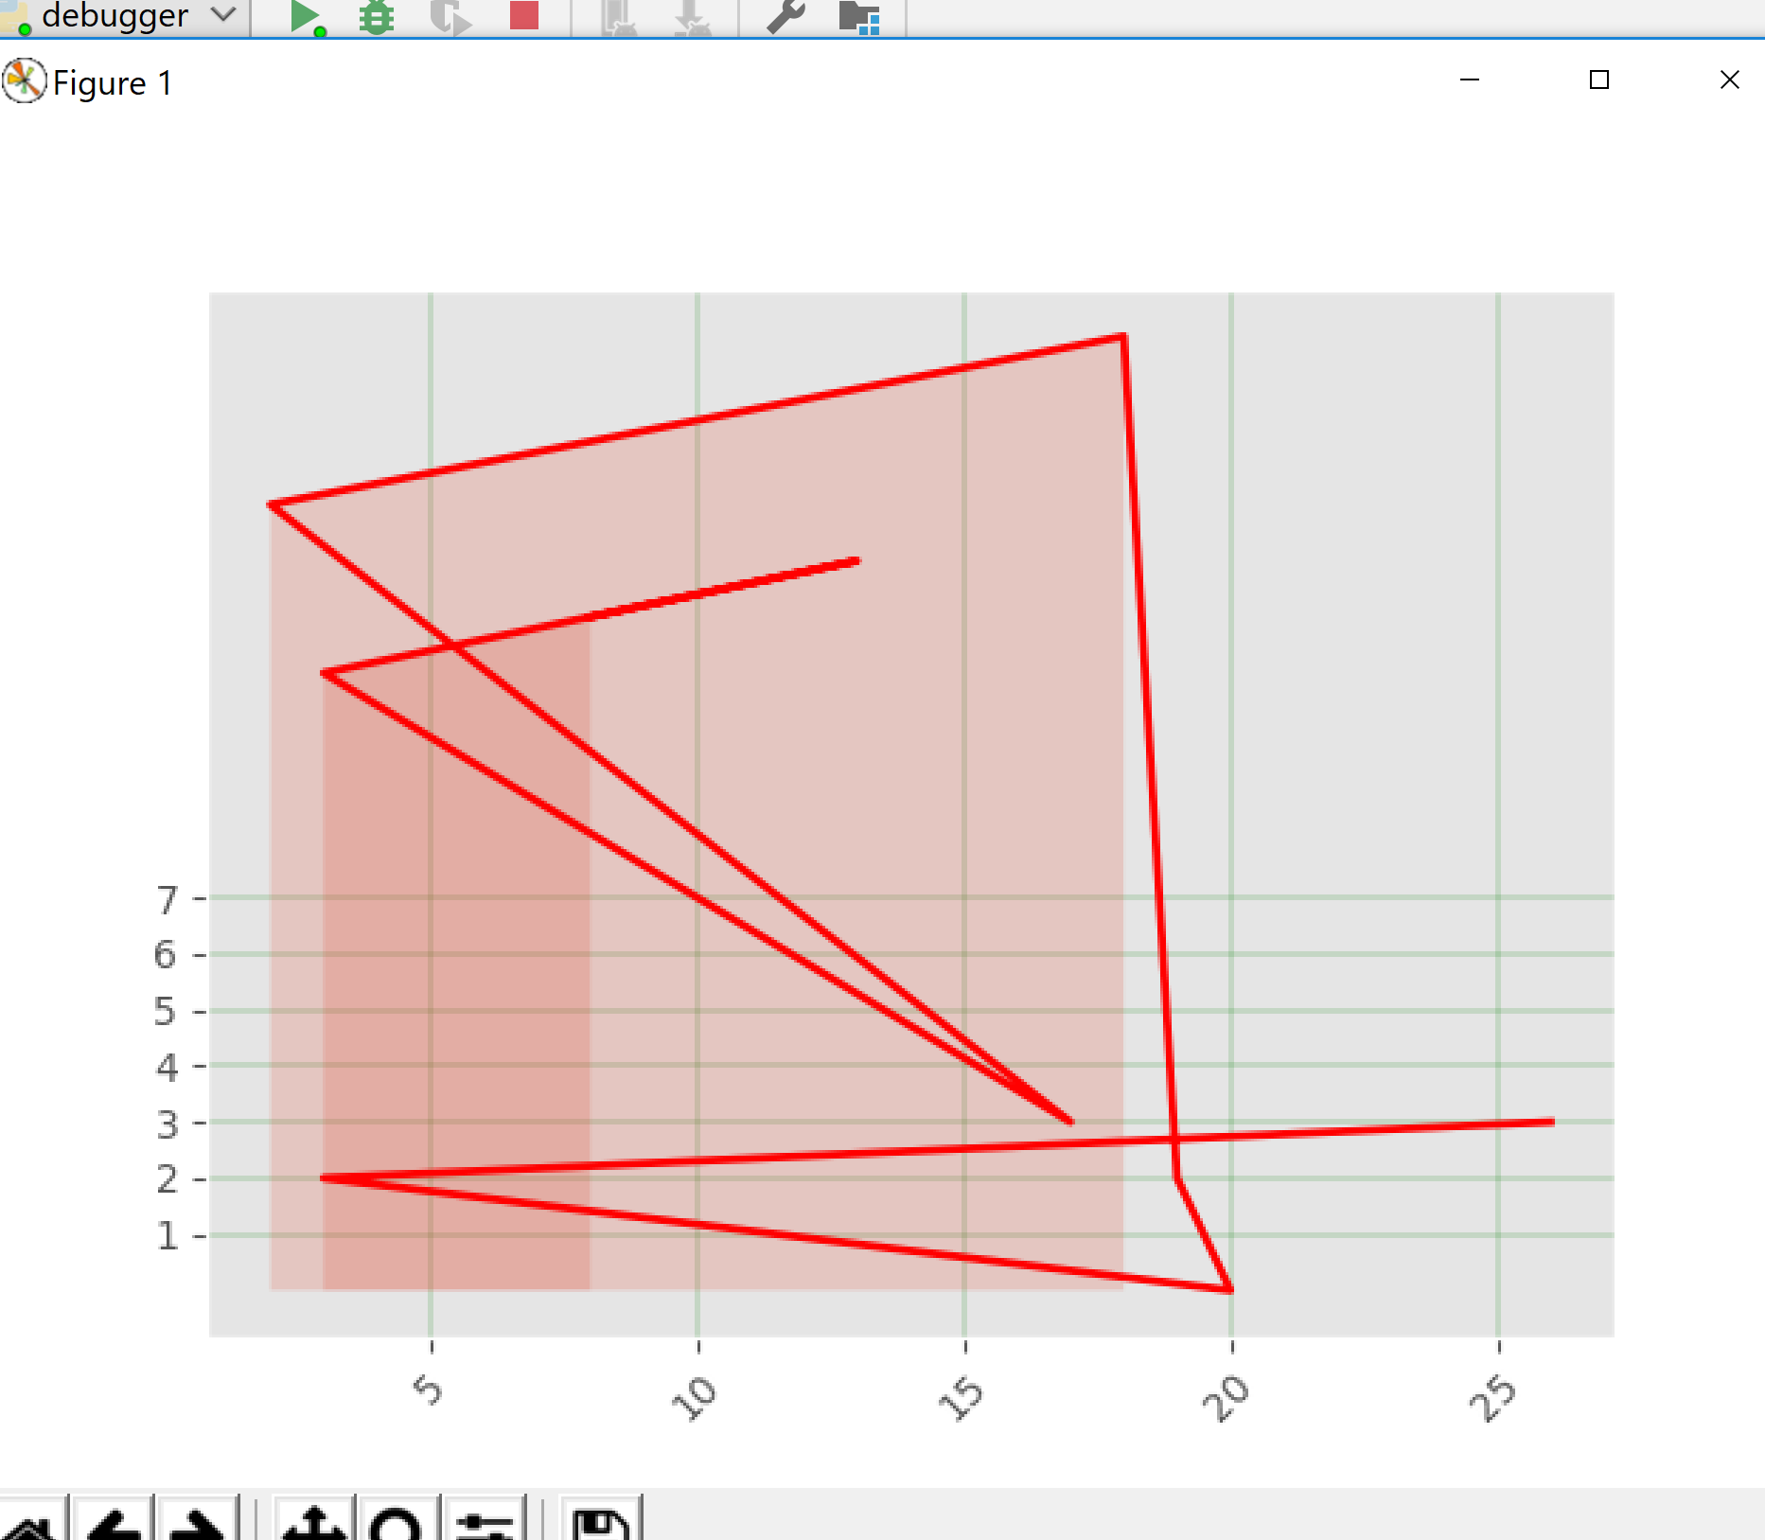
Output

Slide 23
Great job now lets move Ahead !
Great work so far now go ahead and pracctise these example code guven to you.
Python challenge:
Your Task is to create 3 line using matlotlib go ahead and create 3 lines you may use numpy and generate a random number and plot it using matplotlib also make sure to use x label and y label make sure to rescale the x and y axis accordingly. Use three color Red,Green ,Blue for three different line.

Slide 24
Loading data using from Text File
Now let us learn how to load data from a text file using csv library.
There are several ways to achieve this using numpy or using logic we shall use CSV module to do the job,.

Slide 25
Loading Data using Matplotlib
First we need to import the necessary library we do that by following command.
# import the necessary library try: # import the necessary library import matplotlib.pyplot as plt import numpy as np from matplotlib import style import csv except: # if import fails display error print("Error cannot find the library !")

Slide 26
Step 2
Now we need to create a two list so that we can append our result into list and later use those list tp plot points using matplotplotlib
We definetwo list x and y
# create a blank list for plot x=[] y=[]

Slide 27
Logic to read Data from Text File
We need to use with open syntax to open a text file we need to pass argument name of the file and also we ewant to read or write to file. In this case we need to read from file following syntax shows that we need to read from file.
Delimiter is used to separate the data after , from a text file.
# open the file with open("sample.txt", "r") as fname: # use CSV module to read the text data=csv.reader(fname,delimiter=',')

Slide 28
Plot the Graph
Whenever we execute a print statements we will come to know that its is csv class object. In order to get data we need a for loop which can be seen in example below
for line in data: if len(line) >= 1: x.append(line[0]) y.append(line[1])
plt.plot(x,y) plt.show()

Slide 29
Python Master Challenge
Introducing the concepts of live graph. Let us understand how to create a live graph. This can be useful when working with sensor and actuator.
We shall use the animation function from the matplotlib library and try and understand the concepts and try to make out own live Graph.

Slide 30
Step 1: importing the necessary library
try: import matplotlib.pyplot as plt # use to plot the graph import numpy as np # used to generate random number import matplotlib.animation as animation # used for live graph from matplotlib.backends.backend_tkagg import FigureCanvasAgg,NavigationToolbar2Tk import csv # used to seperate data by comma from matplotlib import style # make Graph look little better except: print("Library not Found

Slide 31
Define the figure and axis
fig=plt.figure() ax1=fig.add_subplot(111) x=[] y=[]

Slide 32
Get Data
def get_data(): with open("sample.txt","r") as fname: data=csv.reader(fname,delimiter=",") for line in data: if len(line) >= 1: x.append(line[0]) y.append(line[1])

Slide 33
Plot the data
def animate(i): get_data() ax1.clear() ax1.plot(x,y) if __name__ == "__main__": ani= animation.FuncAnimation(fig, animate, interval=2000) plt.show()

Slide 34
Thanks
You may ask your questions if you have any ?
Send your feedback at soushah@my.Bridgeport.edu

